Slide 1

School Billing System
Group Members: 3rd Sem, ISE
Aadarsh Raj
Divyang Awasthi
Rishabh Anand
Shikhar Jaiswal

Slide 2
Index
Problem Statement
Objectives
Architectural Diagram ( Flow Chart )
Algorithm
Result Analysis
Conclusion
References

Slide 3
Problem Statement/Introduction
The School Billing System enables the school administration to manage and keep records of the students which includes their name, class, admission number.

Slide 4
Objective
It helps in managing the database of students efficiently.
This program decreases the human errors in fee calculation.
It reduces the paperwork and hence helps in saving the environment.

Slide 5
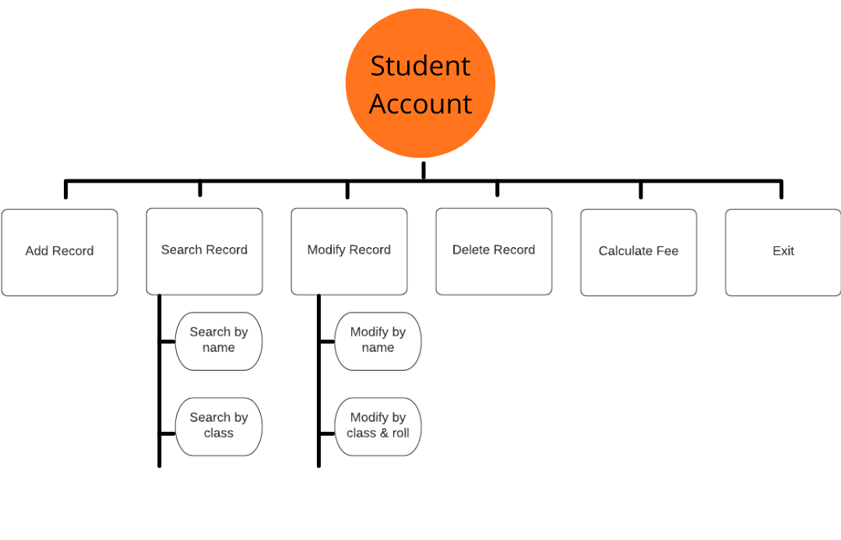
Program Overview

Slide 6
Algorithm
Step-1-> Start
Step-2-> Enter the current date and month as the fee and fine would be calculated accordingly
Functions Used:
ADD RECORD-->
Add record of the students
MODIFYING RECORD-->
Select an option to modify the details of the record using name OR name, class and roll no.

Slide 7
Algorithm
SEARCHING RECORD-->
Select an option to search the record using name OR class
DELETING RECORD-->
Enter the name of the student to delete the record
CALCULATING FEE-->
Enter the name, class, roll no. and the month till which fee has to be paid
EXIT

Slide 8
Conclusion
This program provides complete automation of all operations.
It can be operated very easily. There is no need to recruit extra dedicated person or equipment to handle this application.
It provides user friendly function. Though we have already added many features to this application, this application can be made more flexible and professional.

Slide 9


References
RVITM Modules For Data Structures & Applications (18CS32)
www.geeksforgeeks.org
www.overiq.com
www.tutorialdost.com
Books
Let Us C - Yashavant Kanetkar

Slide 10
THANK YOU

